Slide 1
Math 769: Statistical Learning

Slide 2
Bias, Variance, and Model Complexity
Shahrzad Jamshidi, PhD

Slide 3
Last Time
Modeling based on local data:
Kernel smoothing functions
Local linear and polynomial regression

Slide 4
Objectives
Model bias and model variance to explain the tradeoff between the two.
List 4 examples of loss functions
Define two kinds of model error to evaluate bias versus variance.
Explain why training error is not good for this purpose.
Describe the purpose of a training-validation-test split of the dataset.

Slide 5
Bias versus Variance
Statistical models balance an important tradeoff:
bias (error from erroneous assumptions) and
variance (error from sensitivity to fluctuations in the training set).
The goal is to find a sweet spot that minimizes total error.

Slide 6
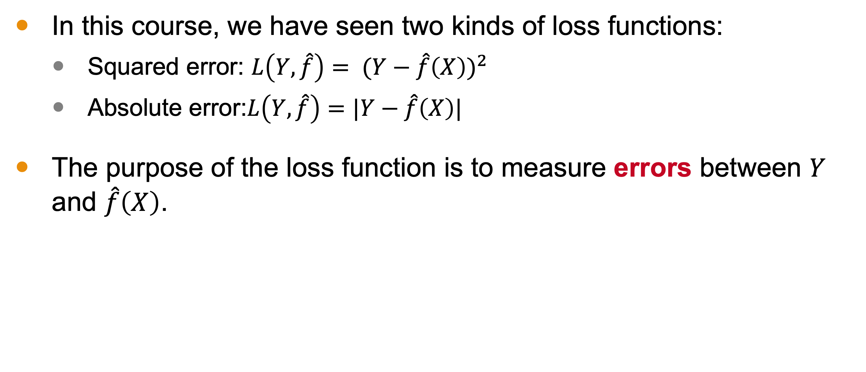
Loss Functions
In this course, we have seen two kinds of loss functions:
Squared error: ${L\left(Y,\hat{f}\right)= (Y−\hat{f}\left(X\right))}^{2}$
Absolute error:$L\left(Y,\hat{f}\right)=|Y−\hat{f}\left(X\right)|$
The purpose of the loss function is to measure errors between $Y$ and $\hat{f}\left(X\right)$.

Slide 7
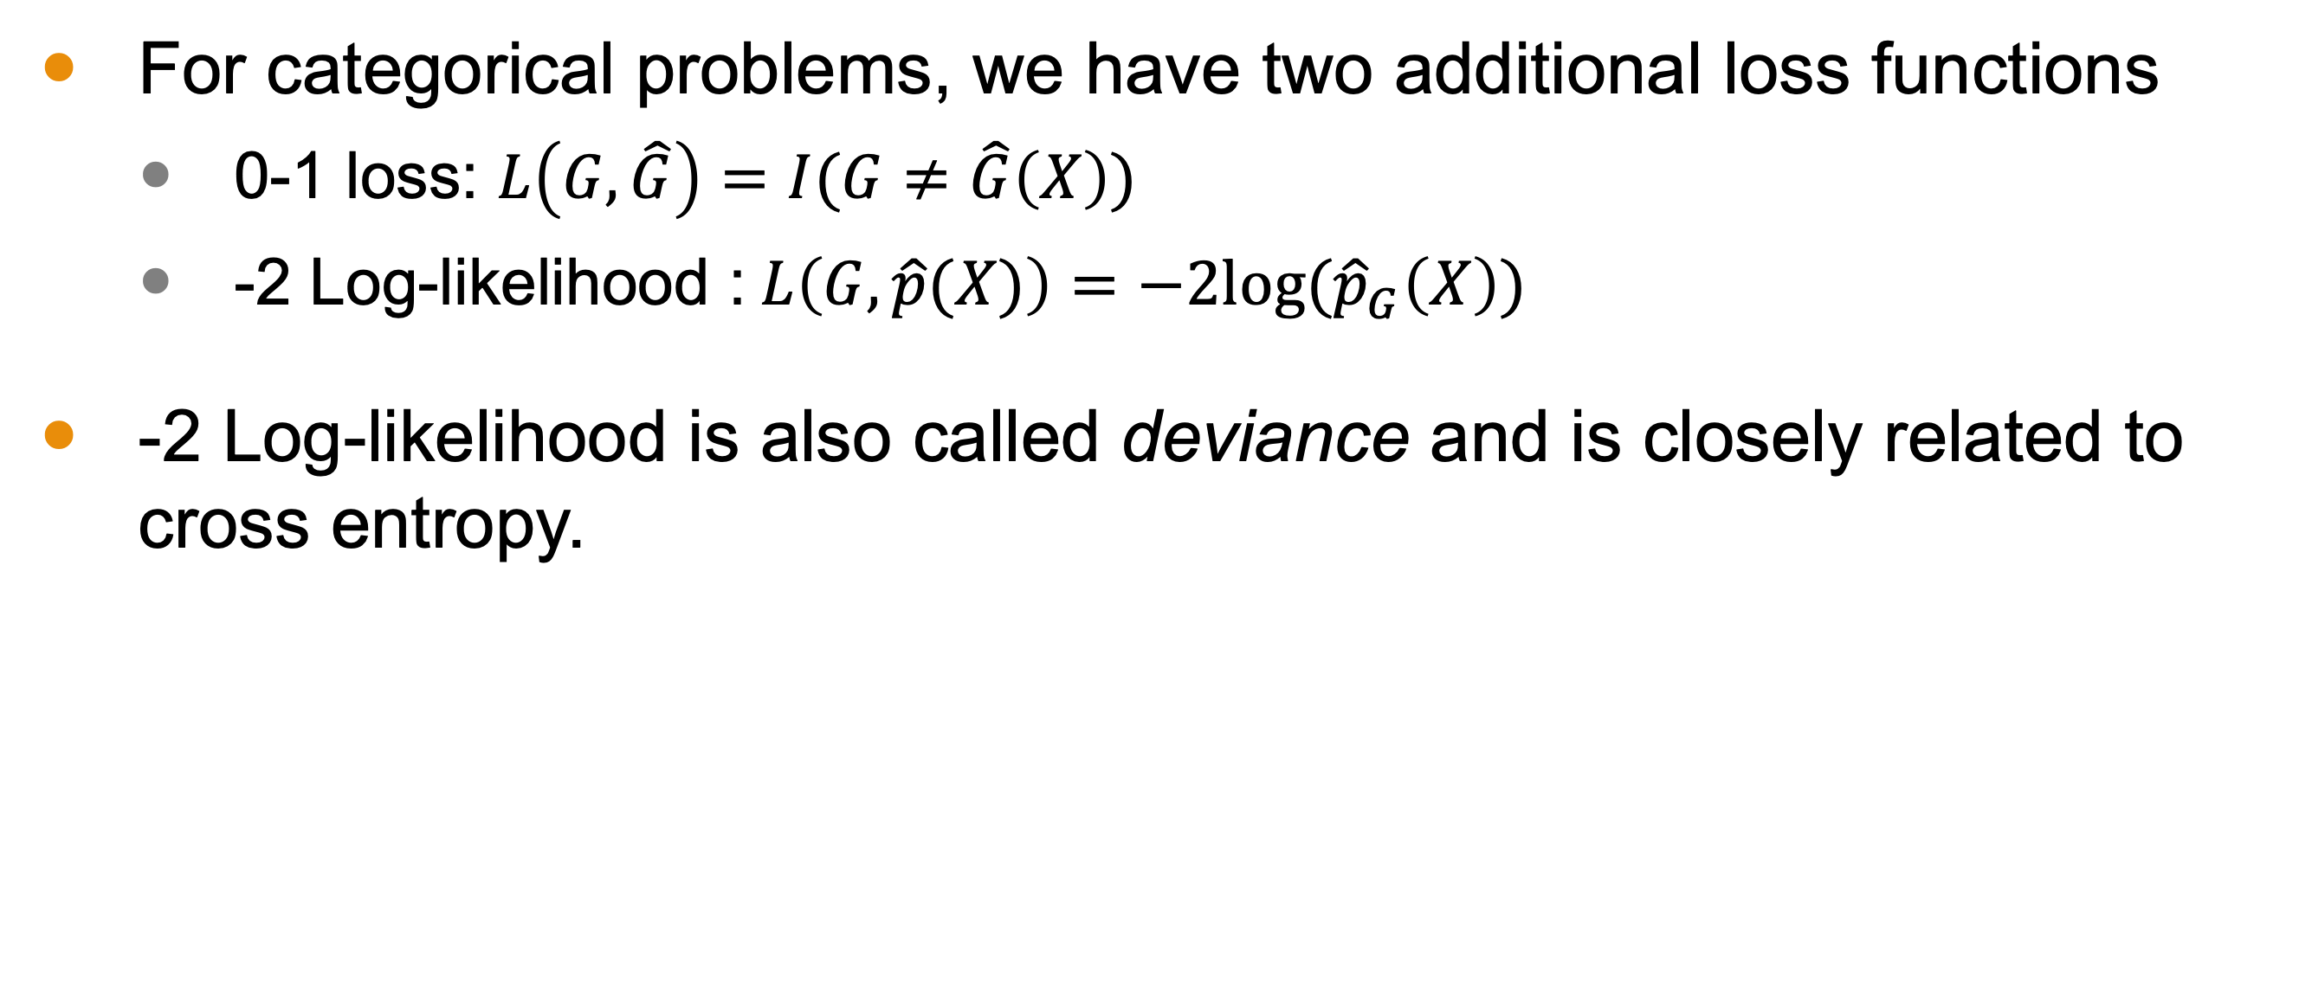
Categorical Loss Functions
For categorical problems, we have two additional loss functions
0-1 loss: $L\left(G,\hat{G}\right)=I(G≠\hat{G}\left(X\right))$
-2 Log-likelihood :$L\left(G,\hat{p}(X)\right)=−2log⁡({\hat{p}}_{G}\left(X\right))$
-2 Log-likelihood is also called deviance and is closely related to cross entropy.

Slide 8
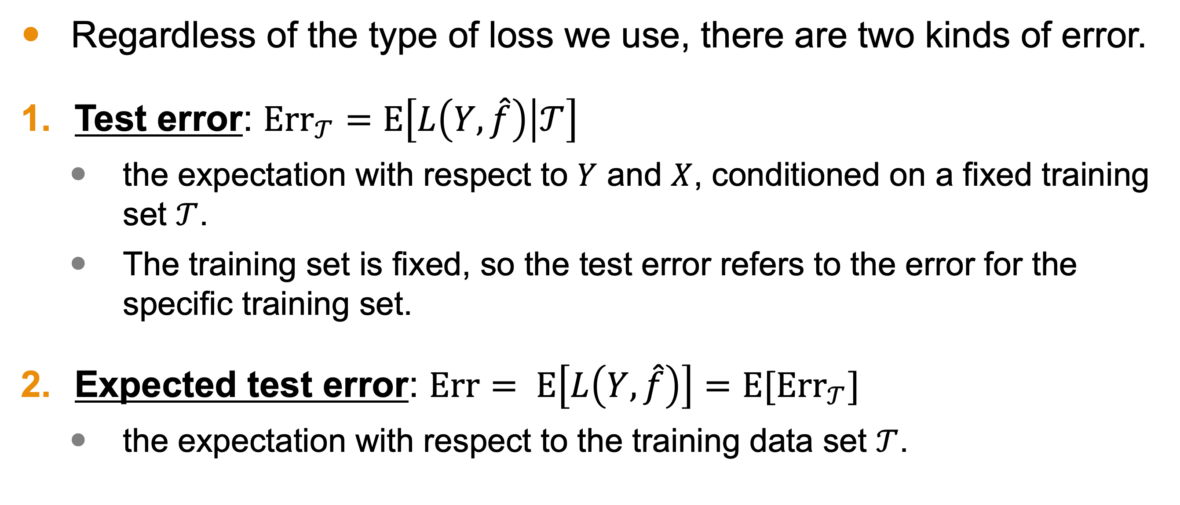
Two kinds of Error
Regardless of the type of loss we use, there are two kinds of error.
Test error: ${\text{Err}}_{𝒯}=E\left[L\left(Y,\hat{f}\right) | 𝒯\right]$
the expectation with respect to $Y$ and $X$, conditioned on a fixed training set $𝒯$.
The training set is fixed, so the test error refers to the error for the specific training set.
Expected test error: $Err= E\left[L\left(Y,\hat{f}\right)\right]=E[{\text{Err}}_{𝒯}]$
the expectation with respect to the training data set $𝒯$.

Slide 9
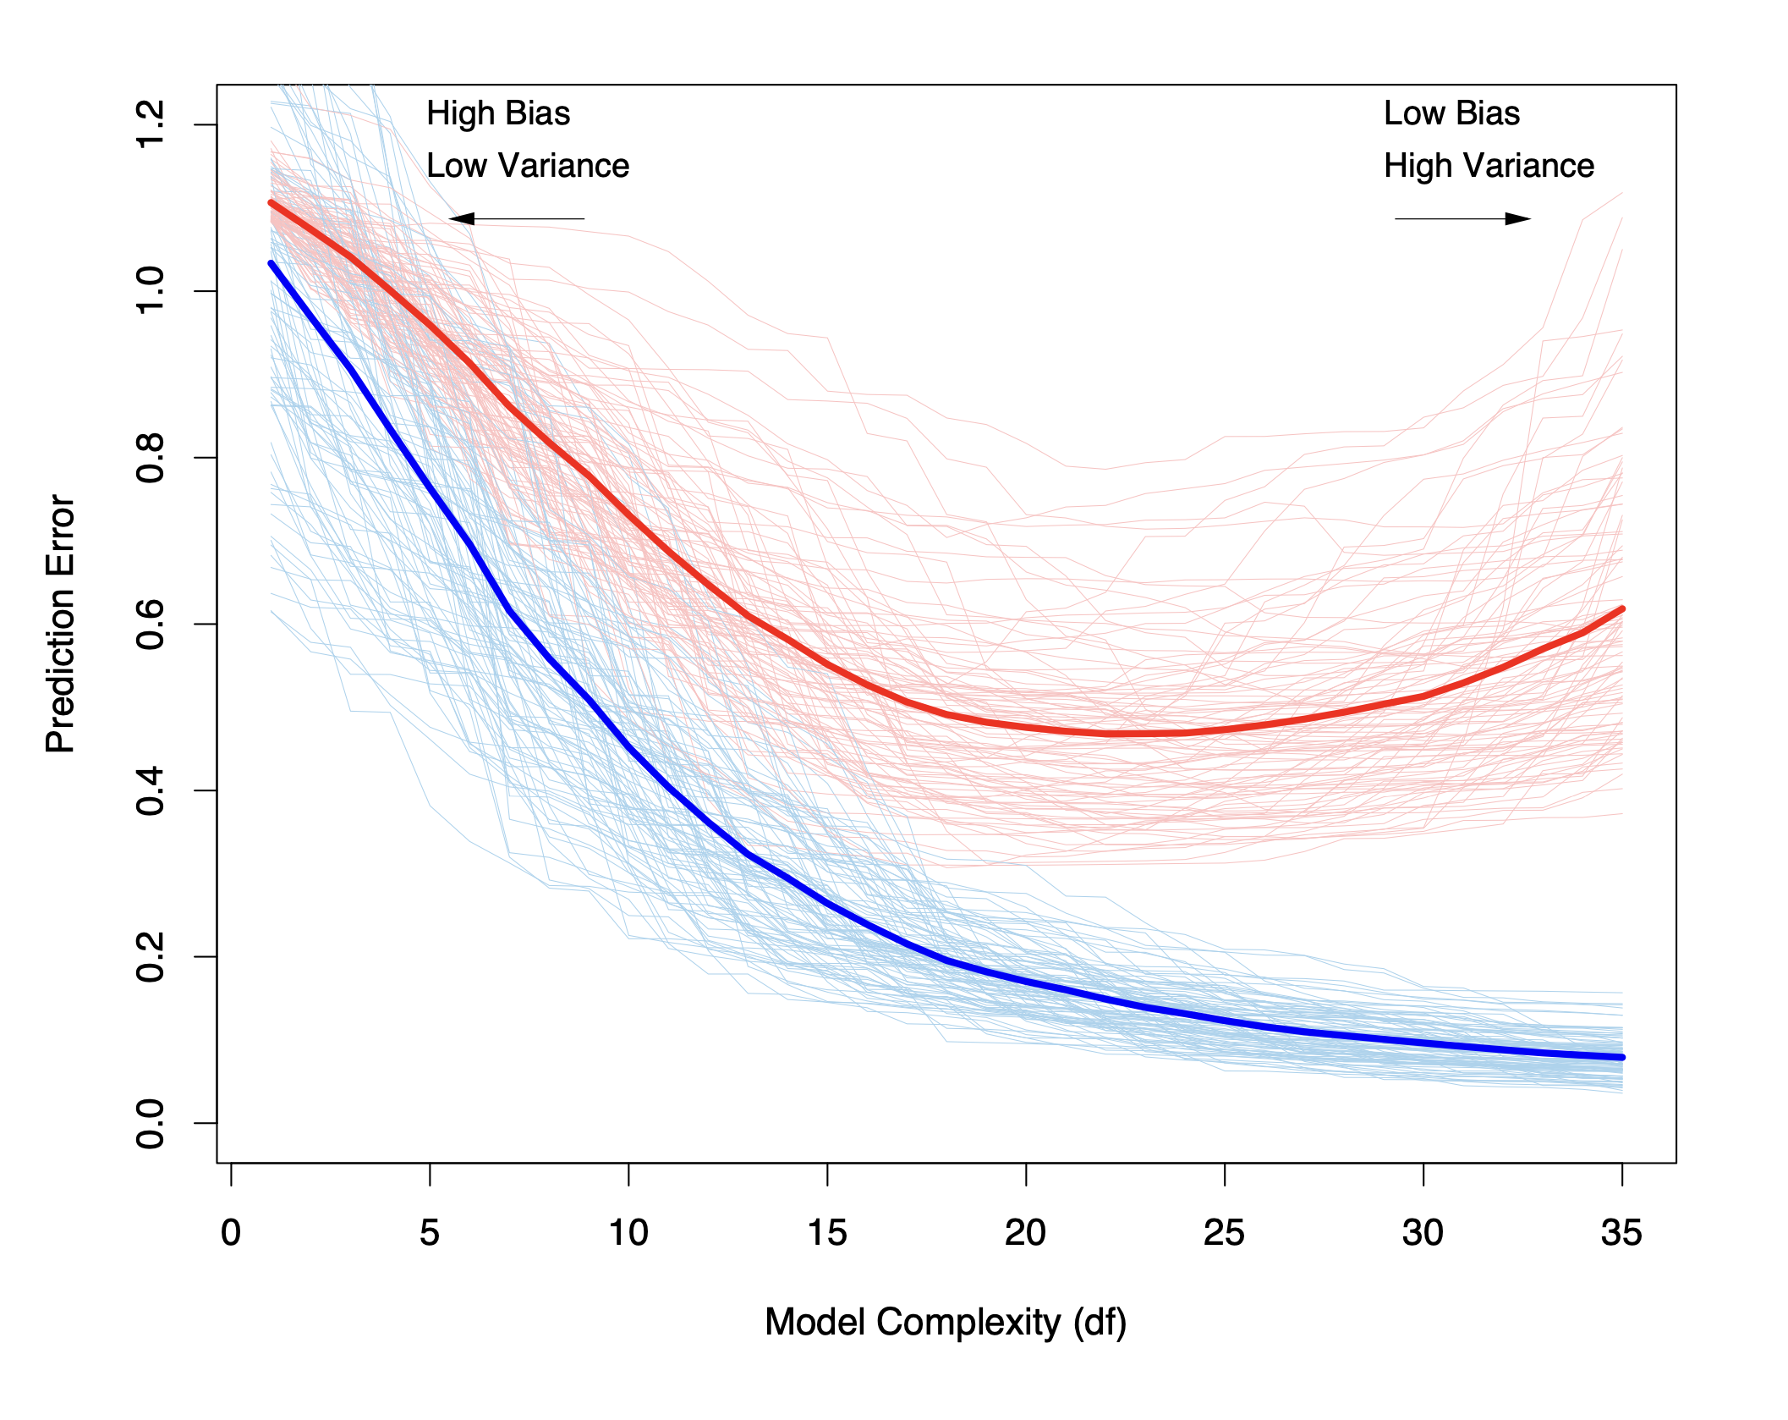
Test Error vs Expected Test Error
In the image to the right, we have the test error depicted in light red of 100 simulated training sets.
The dark red line is the expected test error.
The blue portion are training set error analogs.

Slide 10

Test Error
${\text{Err}}_{𝒯}$ is what we want to know.
$Err$ is easier to understand from a statistical standpoint.

Slide 11
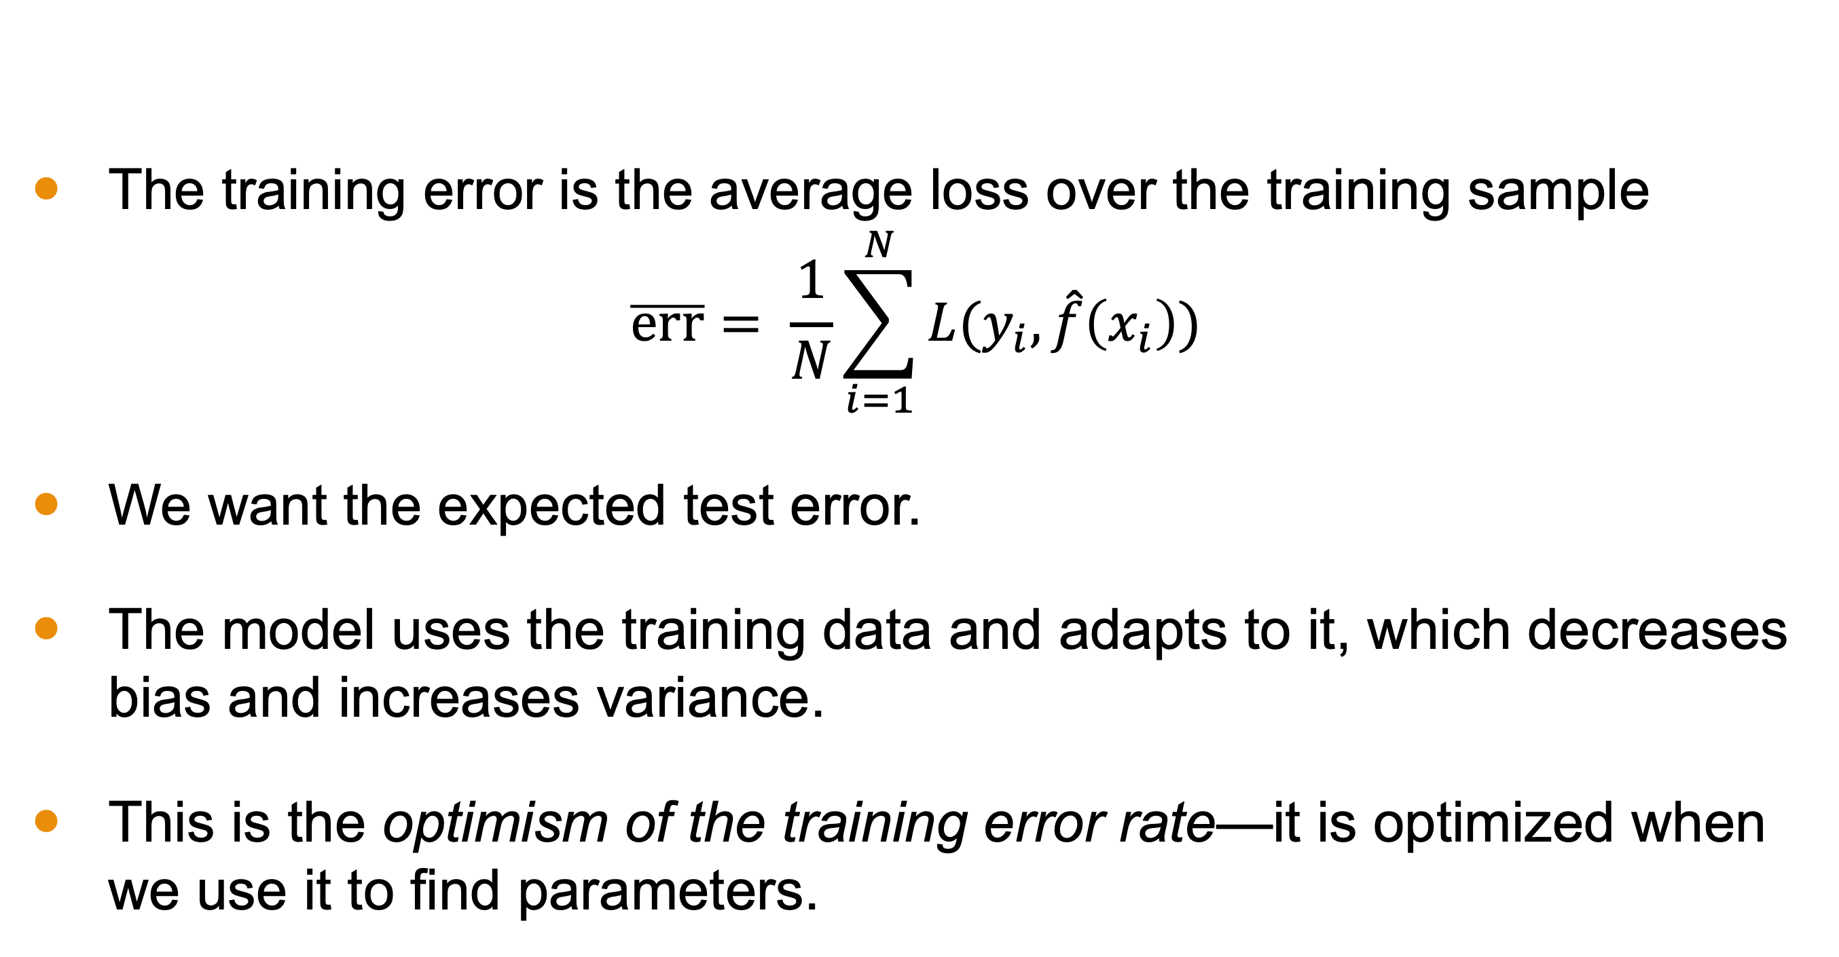
Training Error
The training error is the average loss over the training sample
$$\overline{err}= \frac{1}{N}\sum_{i=1}^{N}{L(y_{i},\hat{f}\left(x_{i}\right))}$$
We want the expected test error.
The model uses the training data and adapts to it, which decreases bias and increases variance.
This is the optimism of the training error rate—it is optimized when we use it to find parameters.

Slide 12
Tuning Parameters and Bias-Variance Tradeoff
An additional consideration: hyperparameters.
Hyperparameters, or tuning parameters, tweak the complexity of the model.
Selecting the optimal level so as to balance bias and variance is ideal.

Slide 13

Two goals
Model selection
Picking optimal hyperparameters
Model assessment
Estimating ${\text{Err}}_{𝒯}$ (or $Err$)

Slide 14
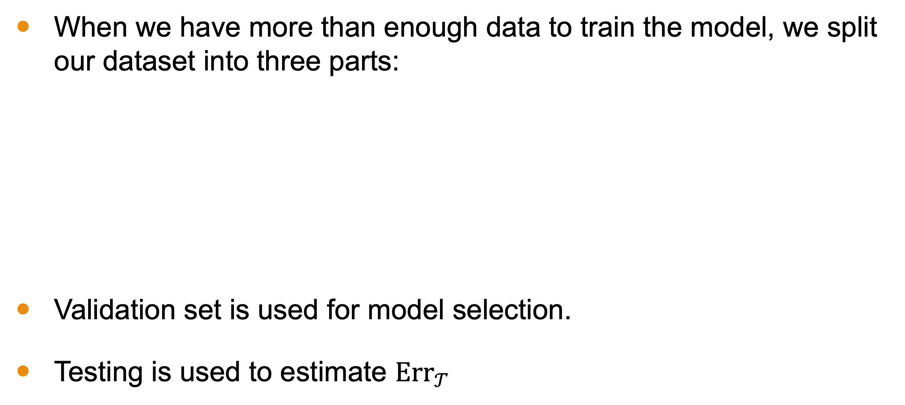
When Data is Abundant
When we have more than enough data to train the model, we split our dataset into three parts:
Validation set is used for model selection.
Testing is used to estimate ${\text{Err}}_{𝒯}$
Training | Validation | Testing
70% | 15% | 15%
80% | 10% | 10%
50% | 25% | 25%

Slide 15
When Data is NOT Abundant
When we do not have an abundance of data, we need to use other methods such as:
AIC
BIC
MDL
Cross Validation
Bootstrapping

Slide 16
Conclusion
When building a model based on a dataset, we wish to balance bias versus variance.
This notion relies on how we measure error and there are several possible loss functions for both regression and classification.
There are two forms of error we can measure, the test error and the expected test error.
The training error will not capture the bias-variance tradeoff.

Slide 17
Conclusion
One aspect of this balance is model selection in the form of choosing hyperparameters.
When we have a large dataset, we simply split the set into three parts:
The training set to find the parameters
The validation set to tune the hyperparameters
The testing set to estimate the test error
When our dataset is too small for this split, we have other methods that we will discuss in this module.

